Slide 1
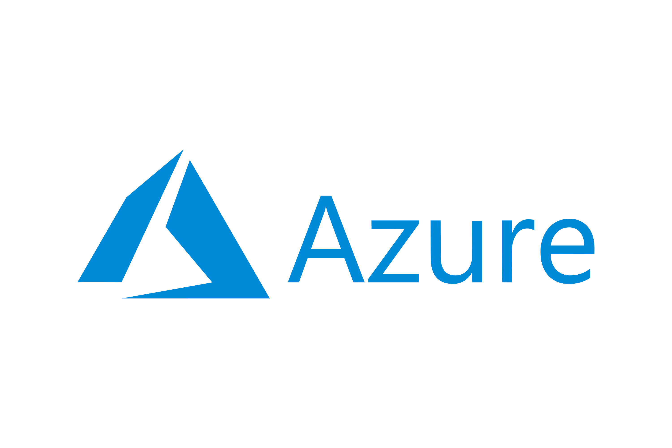
MICROSOFT AZURE
By: Anmol Chaudhary
Analyst A4
Capgemini

Slide 2
WHAT IS CLOUD
?

Slide 3


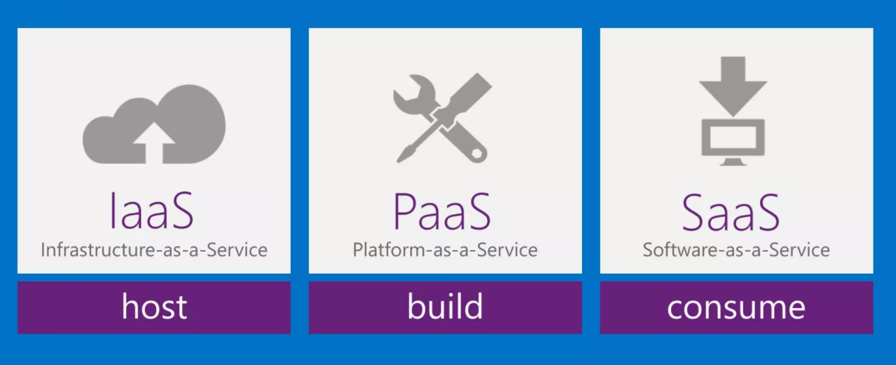
CLOUD COMPUTING MODELS

Slide 4
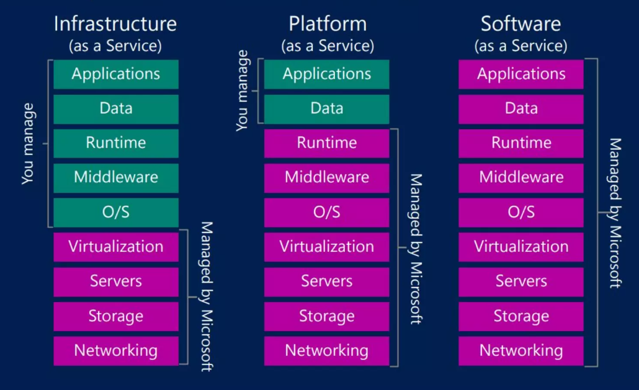

Slide 5
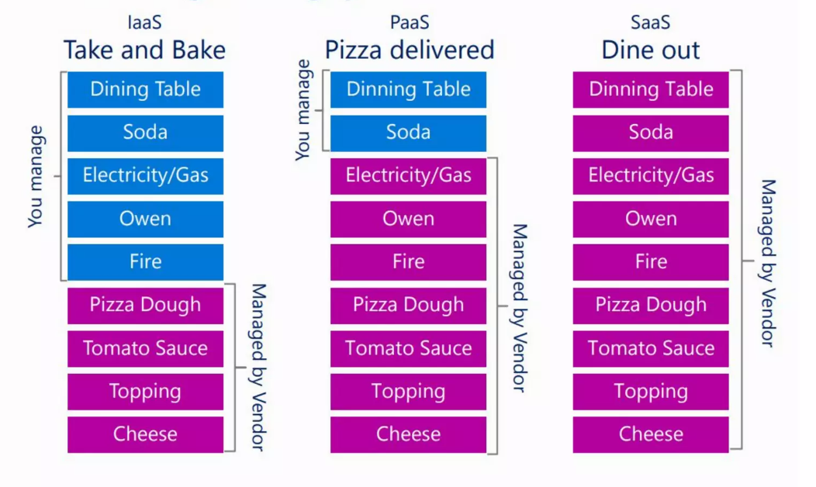

Slide 6
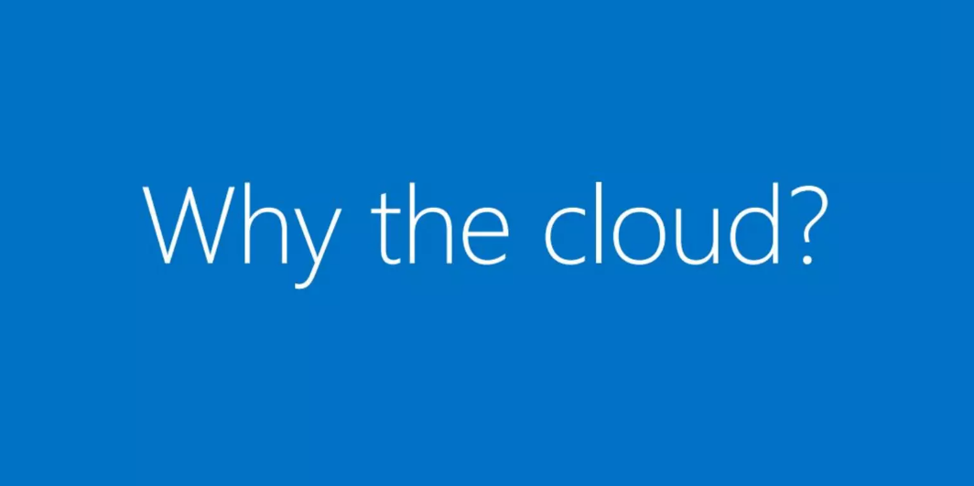

Slide 7
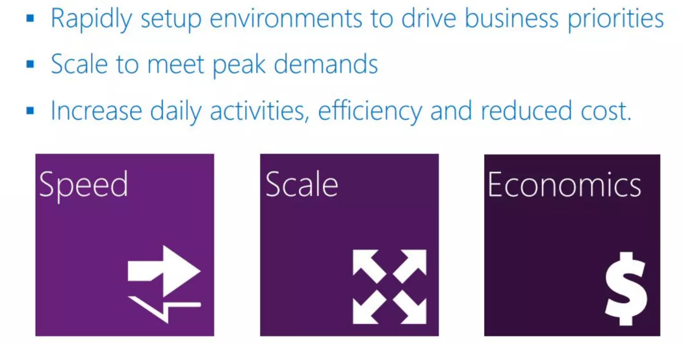

Slide 8
LET’S GET STARTED

Slide 9
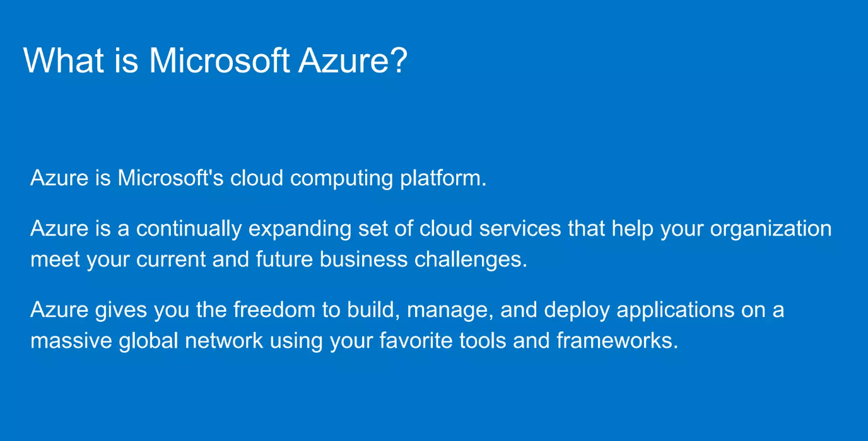

Slide 10
AZURE SERVICES

Slide 11
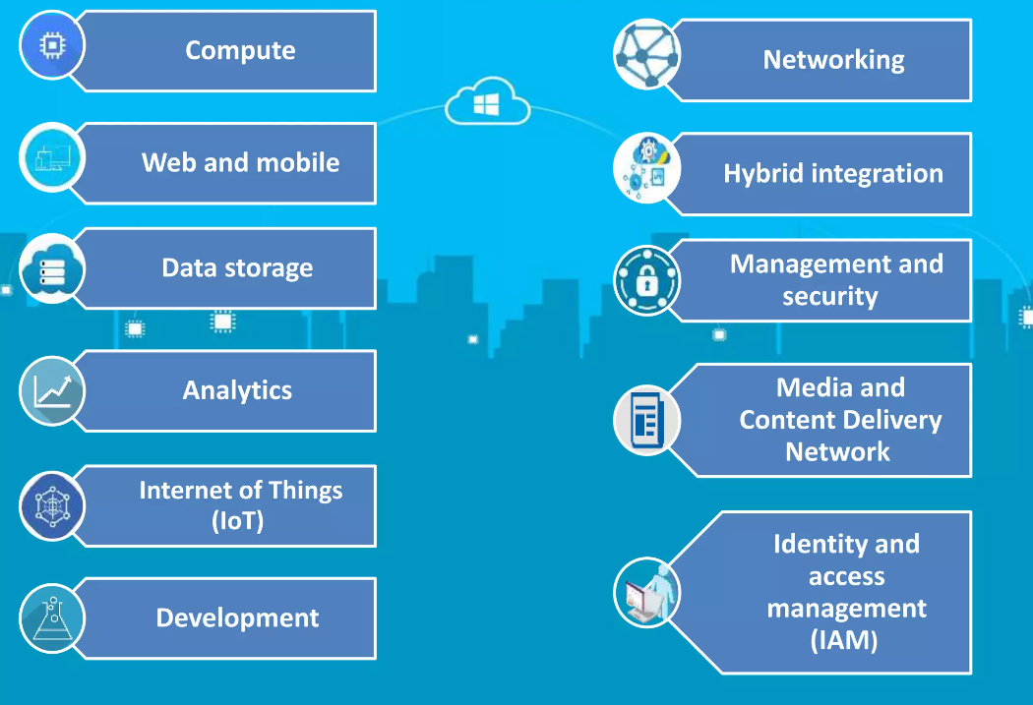

Slide 12
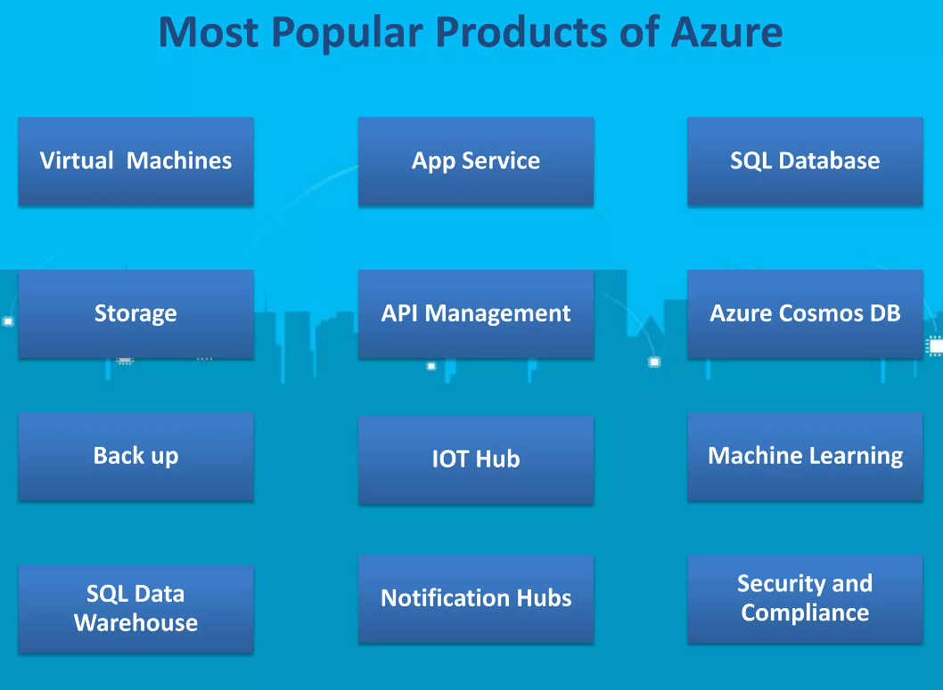

Slide 13
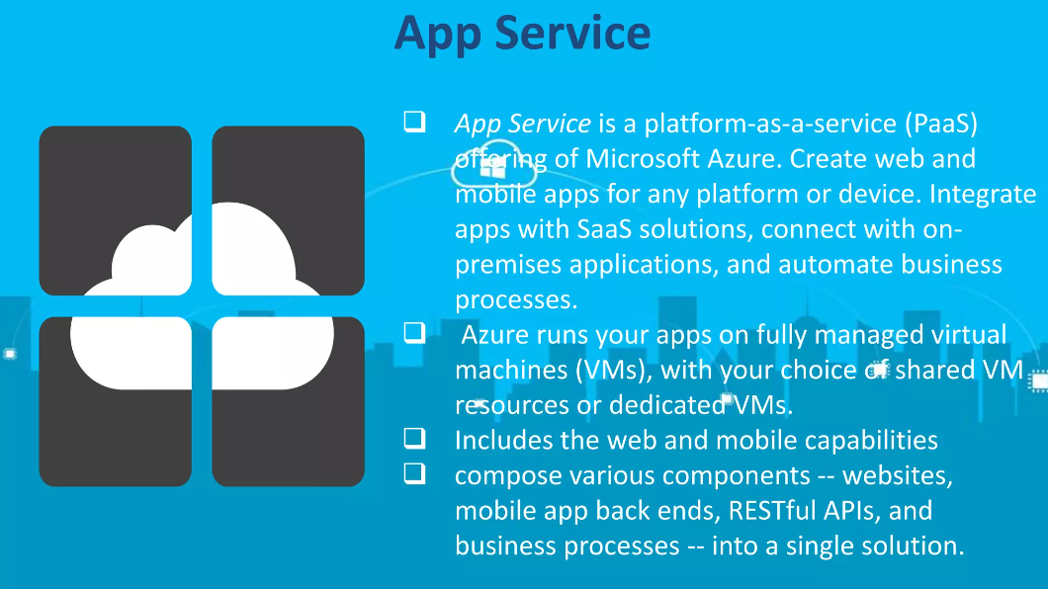

Slide 14
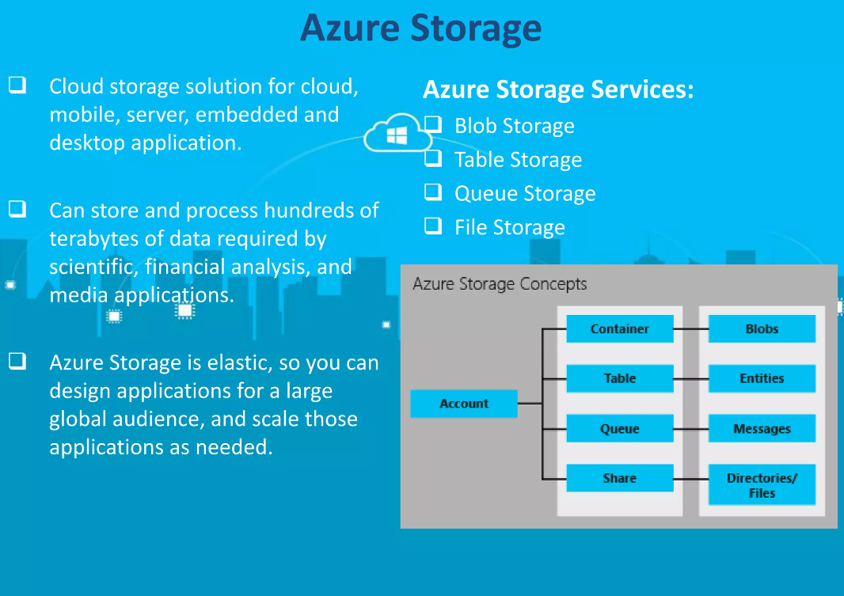

Slide 15
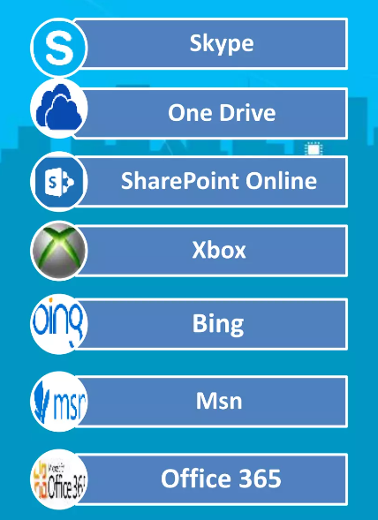
APPLICATION BUILD IN WITH AZURE STORAGE

Slide 16
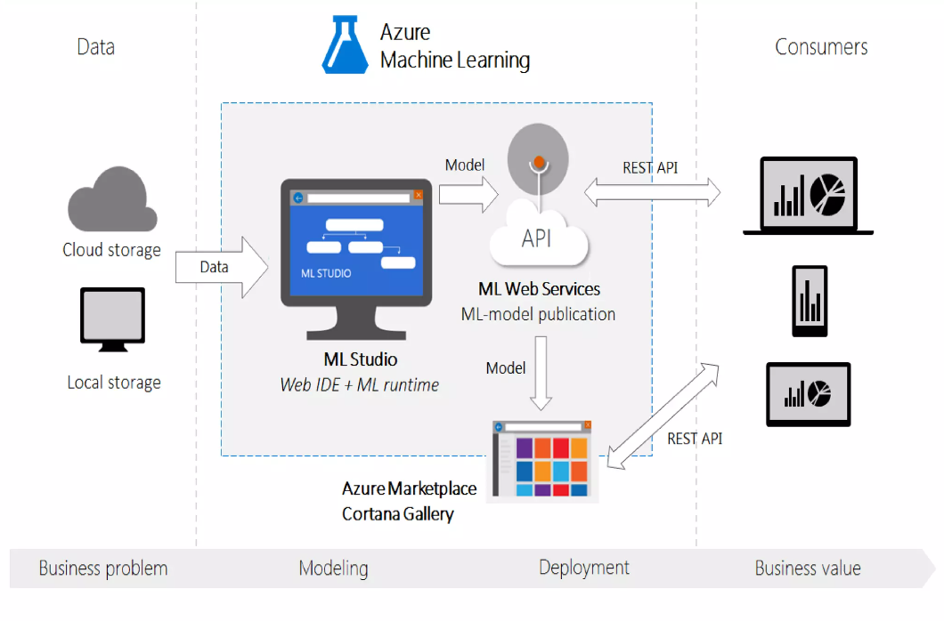

Slide 17
AZURE IoT HUB
Enable highly secure and reliable communication between your Internet of Things (IoT) application and the devices it manages.
Azure IoT Hub provides a cloud-hosted solution back end to connect virtually any device.
Extend your solution from the cloud to the edge with per-device authentication, built-in device management, and scaled provisioning.

Slide 18
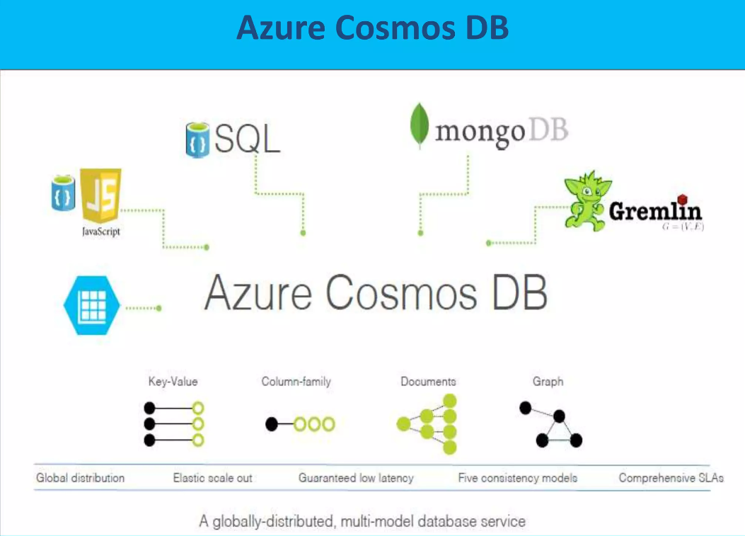

Slide 19
PROS AND CONS

Slide 20
PROS
HIGH AVAILABILITY
DATA SECURITY
SCALABILITY
COST EFFECTIVE
CONS
REQUIRES MANAGEMENT
REQUIRES PLATFORM EXPERTISE

Slide 21
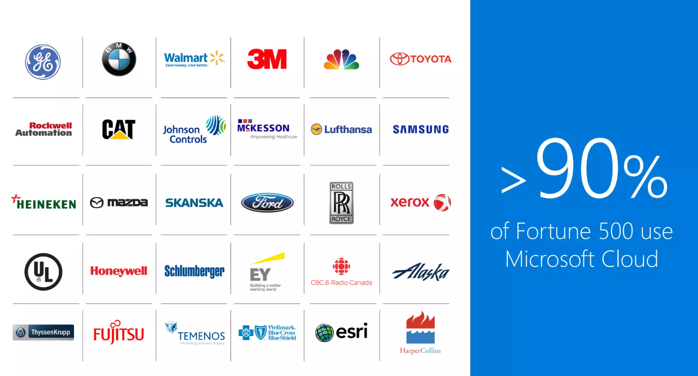

Slide 22
CONCLUSION
If a company requires a powerful Platform-as-a-Service (PaaS) provider or Windows integration, Azure would be the best option.

Slide 23
THANK YOU

